Slide 2
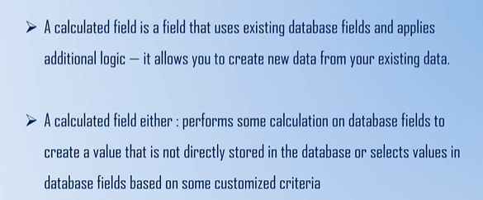
Calculated Field - Definition

Slide 3
Why do we use Calculated Filelds?
To segment data
To convert the data type of a field
To aggregate data
To filter results
To calculate ratios

Slide 4
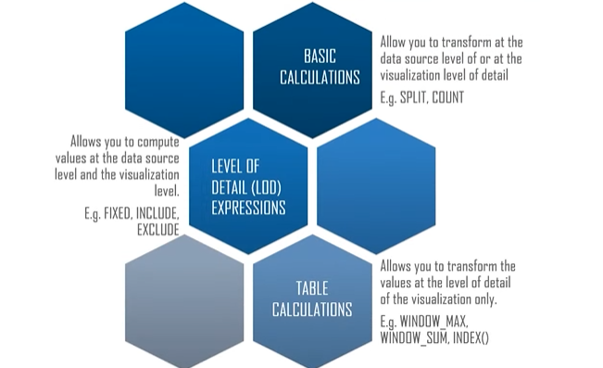
Types of Calculated fields

